Slide 1
Analysis on the Impact of Carbon Dioxide & Other Greenhouse Gases on Sea-Level and Glacier Density
Presented By:
Siddhant Sanjiv Sapte
Saran Tejas Kaja
Pratibha Sridhar Iyengar

Slide 2
Introduction
Climate Change is one of the major concern in the world
Rapid industrial and technological developments lead to increased greenhouse emissions
Environmental sustainability is as important as social and economic sustainability
Global warming causing climate change and rapid glacier melting
We will analyze effect of emissions on the sea-level rising and declining glacier density

Slide 3
DATASETS
Climate change related datasets from UN Data report and EU Data report
Global greenhouse gas emissions(1990-2012)
Emission Value for each Greenhouse gas (1990-2012)
Carbon Dioxide emissions per capita per metric ton (1990-2012)
Carbon dioxide emissions per $1 GDP (PPP, Purchasing Power Parity)
Sea level and glacier density recordings

Slide 4
DATA INTEGRATION
Different sources of data
R Package “countrycode” used to map countries and areas to related continents
Related datasets merged using dplyr and tidyr functions to join datasets

Slide 5
ANALYSIS
Descriptive analysis of
Greenhouse Gas emission
Component Greenhouse Gas emission
Analysis of Carbon Dioxide Emission
Composition of Carbon Dioxide in Greenhouse Gas Emission (%)
Sources of Carbon Dioxide emission
Carbon Dioxide Emission per Dollar of GDP
Clustering Countries based on PPP according to GDP
Analysis and Prediction of Sea Level and Glacier Density
Trend Analysis of Carbon Dioxide emission and Sea level rising
Trend Analysis of Carbon Dioxide emission and Glacier density decline
Prediction of increase in Sea Level and decrease in Glacier Density over next 10 years

Slide 6
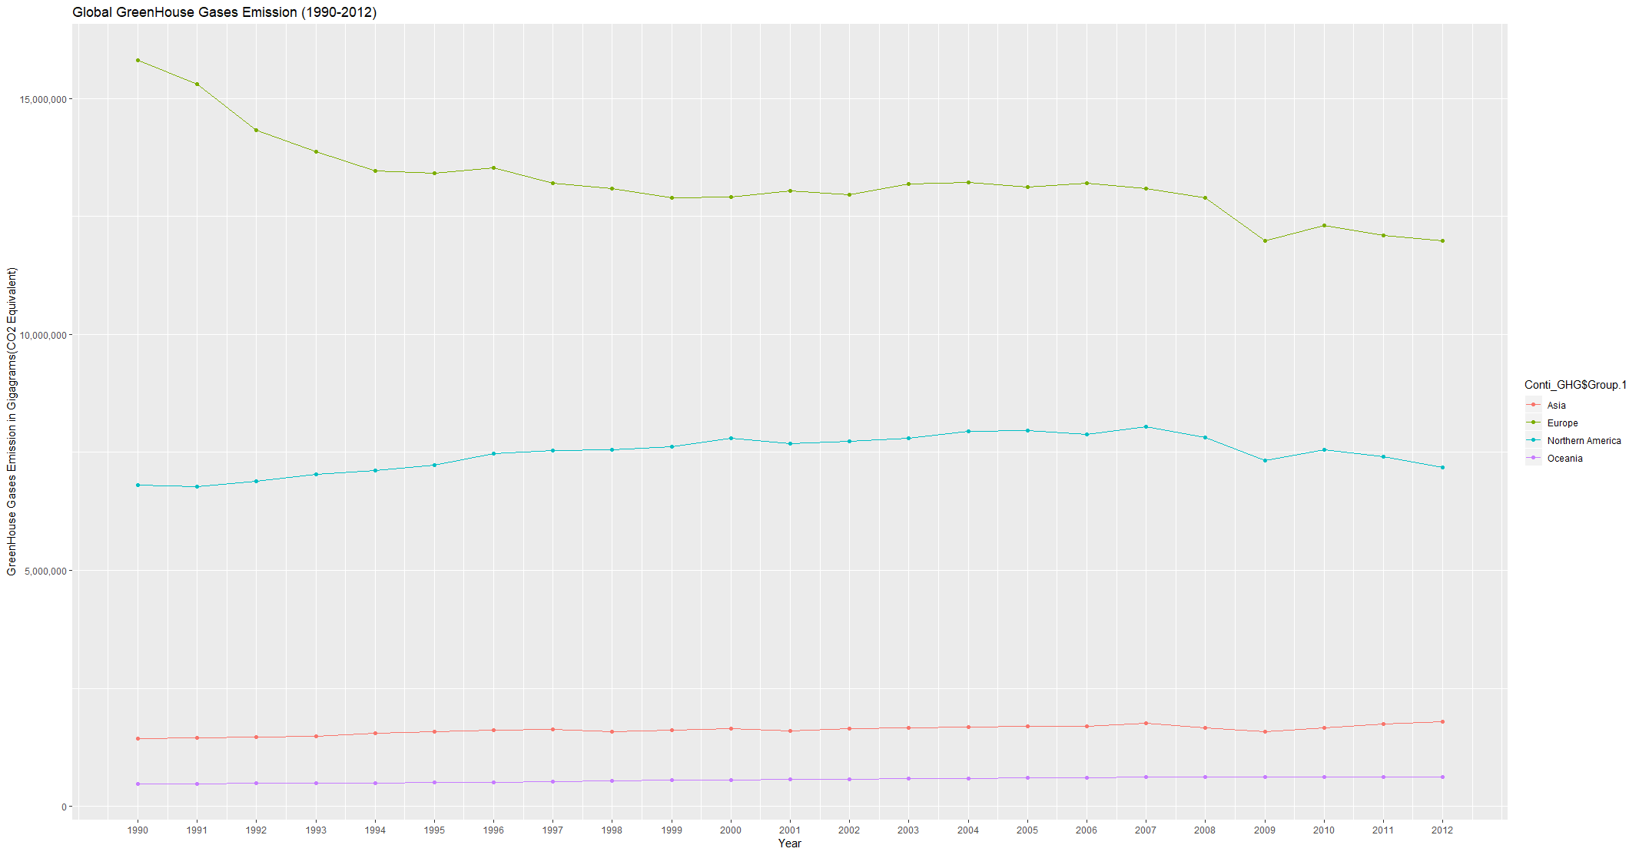
Descriptive analysis
Continent-wise Greenhouse Gas emission

Slide 7
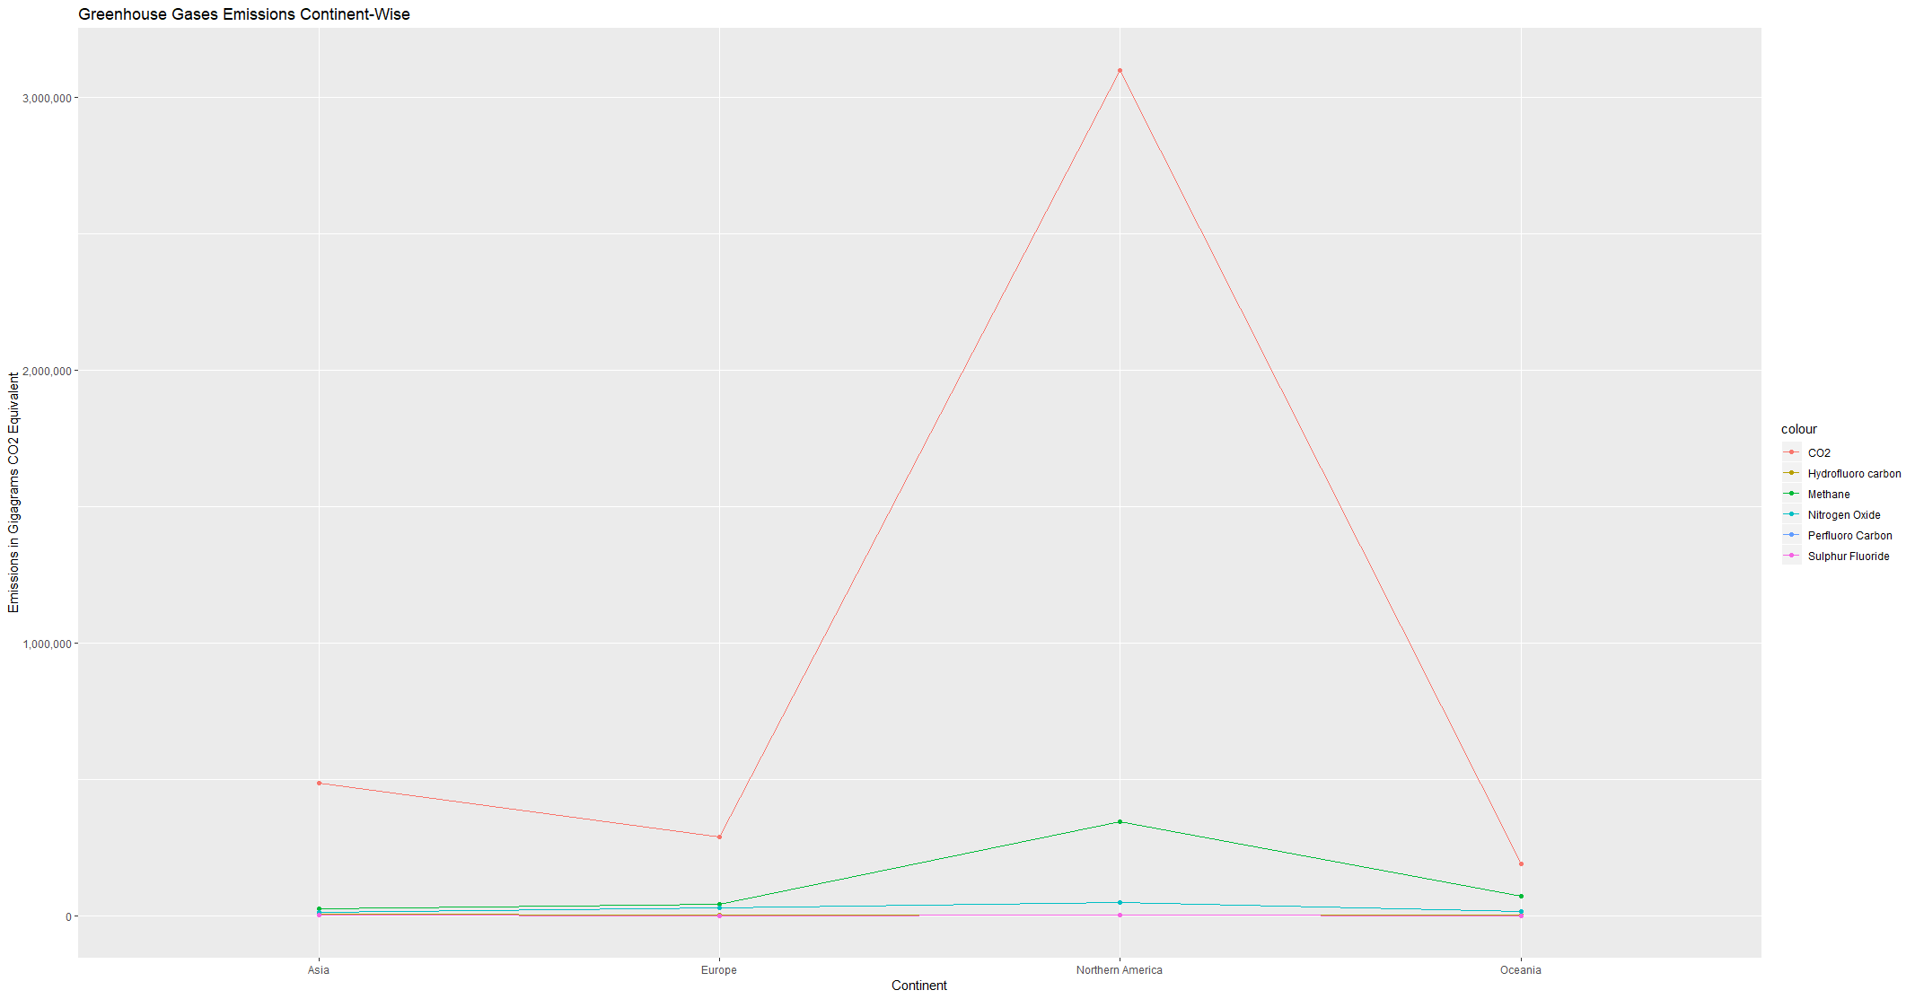
Descriptive Analysis
Continent-wise Component Greenhouse Gas emission

Slide 8
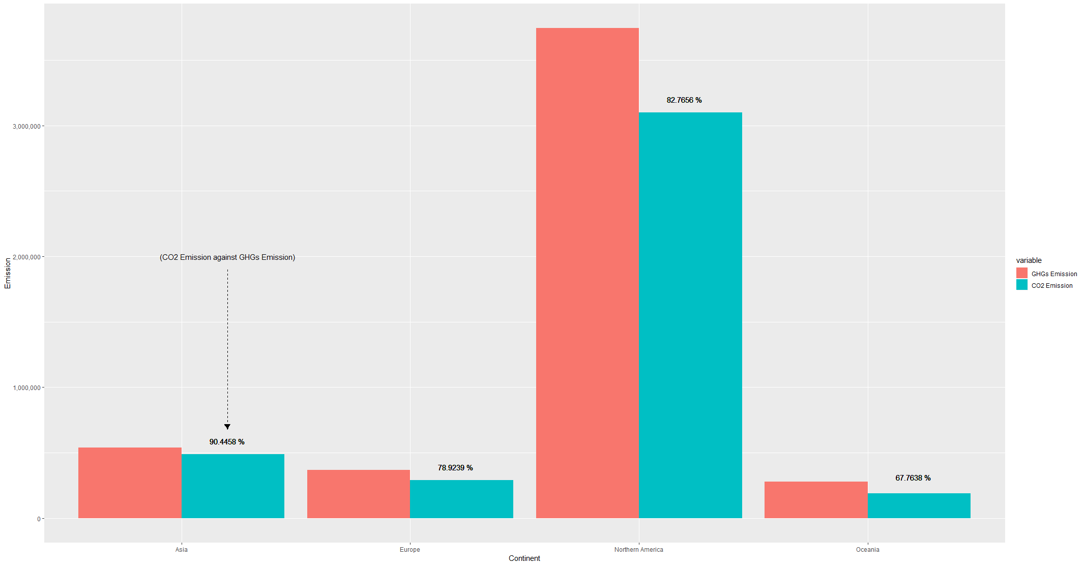
Analysis of Carbon Dioxide Emission
Composition of Carbon Dioxide in Greenhouse Gas Emission (%)

Slide 9
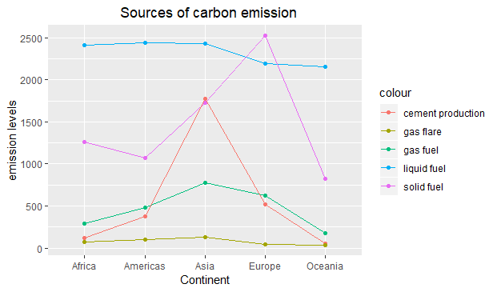
Analysis of Carbon Dioxide Emission
Sources of Carbon Dioxide emission

Slide 10
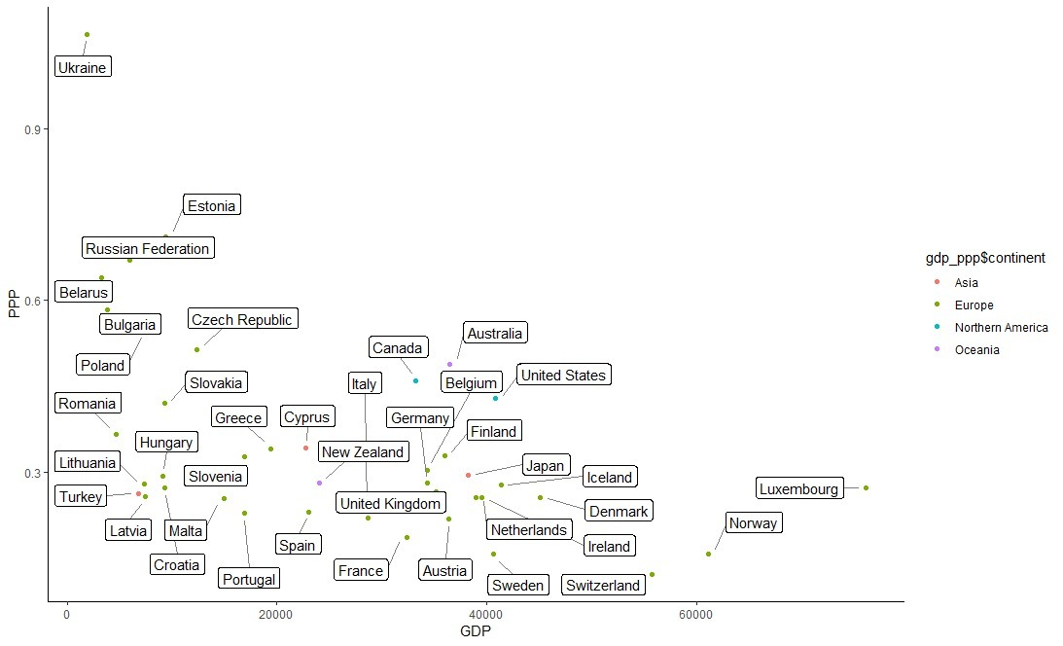
Analysis of Carbon Dioxide Emission
Carbon Dioxide Emission per Dollar of GDP

Slide 11
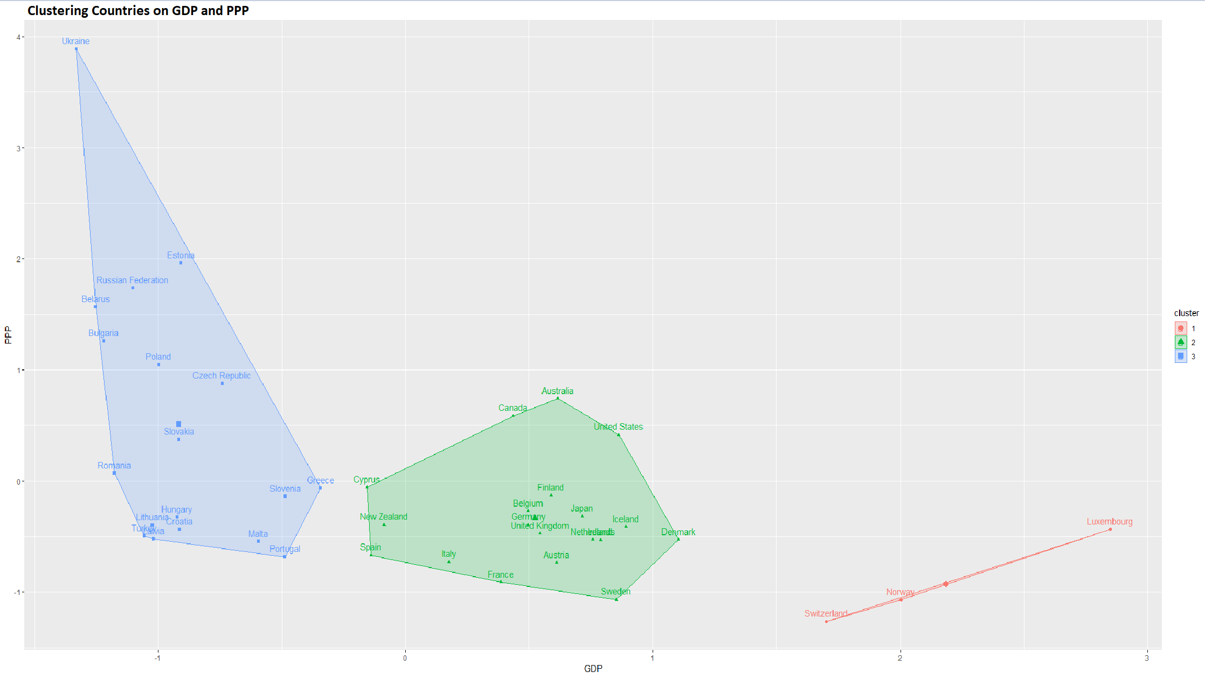
Analysis of Carbon Dioxide Emission
Clustering Countries grouped by GDP for Carbon Dioxide Emission per Dollar GDP

Slide 12
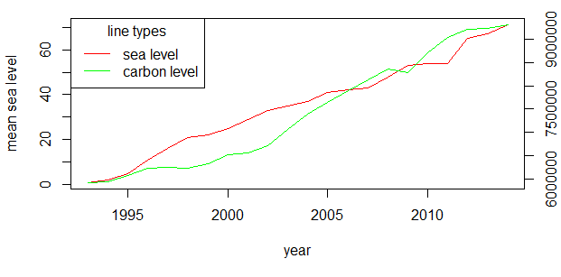
Analysis and Prediction of Sea Level and Glacier Density
Analysis and Prediction of Sea Level and Glacier Density

Slide 13
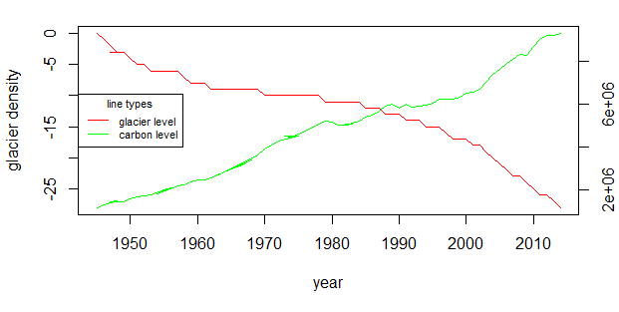
Analysis and Prediction of Sea Level and Glacier Density
Trend Analysis of Carbon Dioxide emission and Glacier density decline

Slide 14
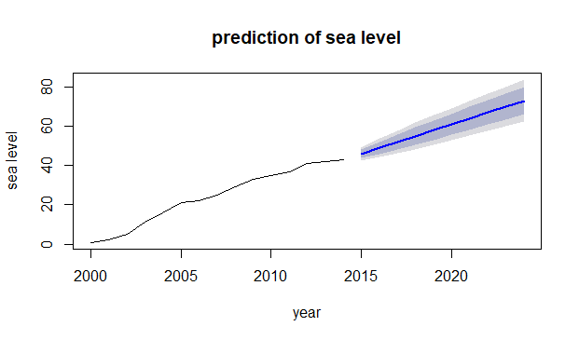
Analysis and Prediction of Sea Level and Glacier Density
Prediction of increase in Sea Level

Slide 15
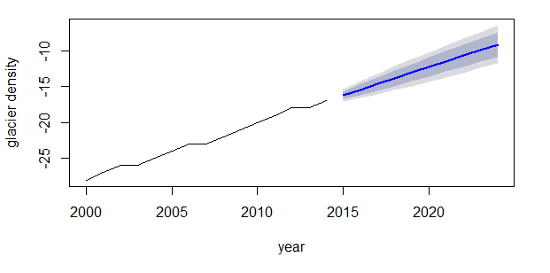
Analysis and Prediction of Sea Level and Glacier Density
Prediction of decrease in Glacier Density

Slide 16
CONCLUSION
Carbon dioxide is the major contributor to Greenhouse gases emissions
Considering the Carbon Dioxide emission per 1$ GDP (Purchasing Power Parity), depicts countries like Ukraine and Estonia contribute more to carbon emission , which means they consume more energy despite low GDP
From the trend and forecast, increase in Carbon Dioxide emission affects the environment
Consequently contributes to rise in sea level and glacier melting

